Slide 1
The Hidden Treasure of Static Analysis
Finding Risks in Forgotten Places

Slide 2

Hello!
Hilary Weaver-Robb
Sr. Software Engineer in Test – Quicken Loans, Detroit MI USA

Slide 3
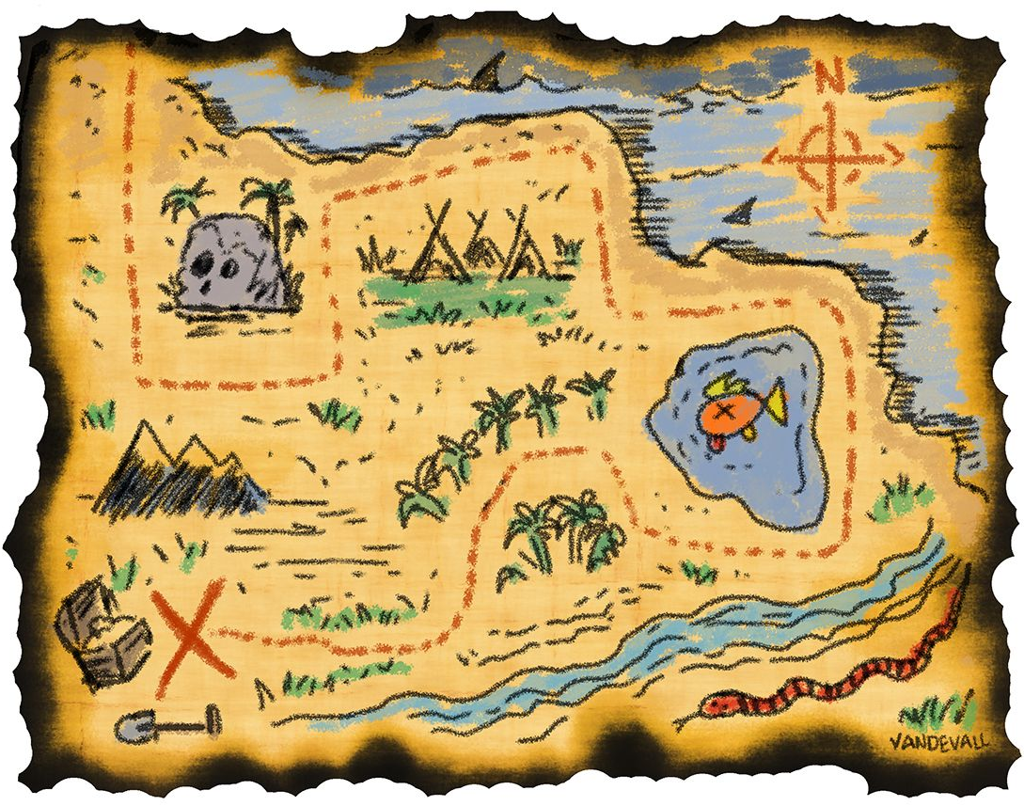
We knew that would stop working eventually, why now?!
Hey I thought we fixed that bug!
Hey I thought we fixed that bug!
Oops we forgot to encrypt passwords!
I thought we had unit tests to cover that!
Prod Deploy

Slide 4
Our Charter
What is Static Analysis?
What is analyzed with Static Analysis?
How to use that info to find and mitigate risk

Slide 5
What is Static Analysis?

Slide 6
Static Analysis is examining the code without executing it; providing understanding of code structure and ensuring the code adheres to industry standards

Slide 7
Static Analysis
“It does not prove that your program is correct. It just provides another set of eyes to help spot problems.”
- JSLint help file

Slide 8
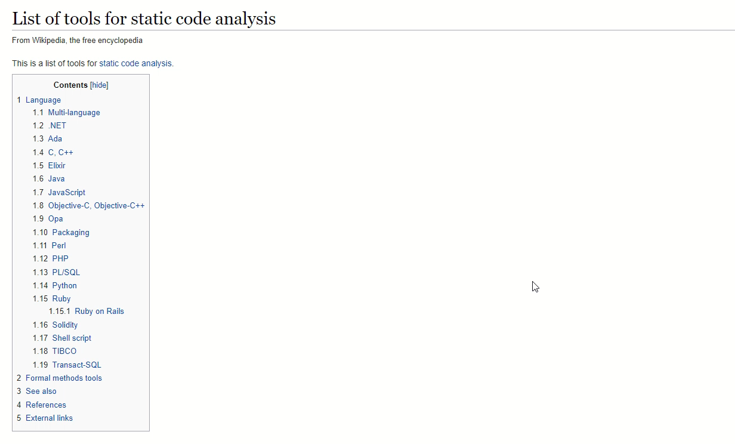

Slide 9
What is analyzed with Static Analysis?

Slide 10
Areas in SonarQube
Reliability
Bugs
Security
Maintainability
Tech Debt, Code Smells
Coverage
Duplications

Slide 11
Issues Encapsulate
Bugs
Vulnerabilities
Code Smells
Duplications
Complexity
Cosmetic

Slide 12
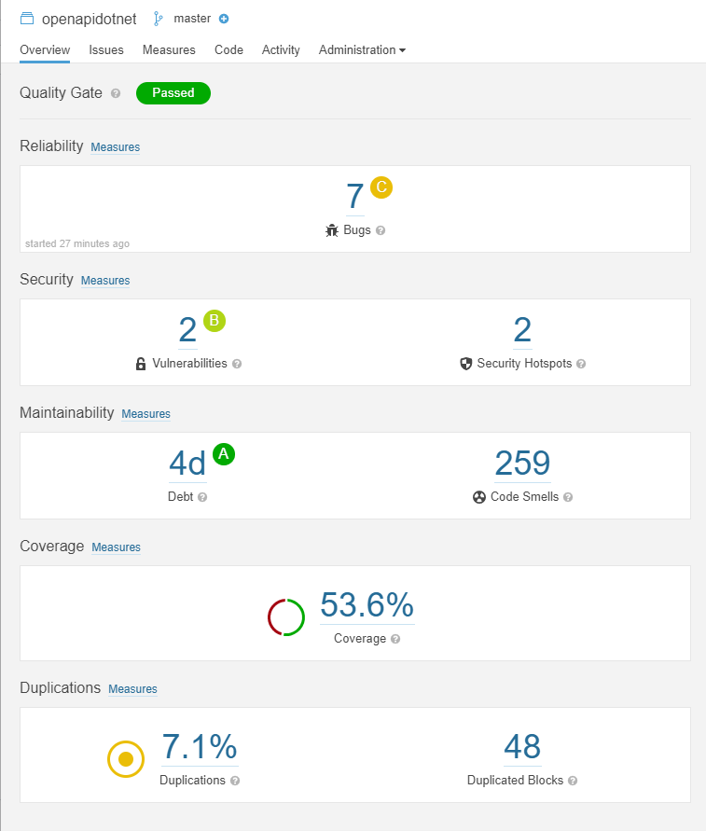

Slide 14
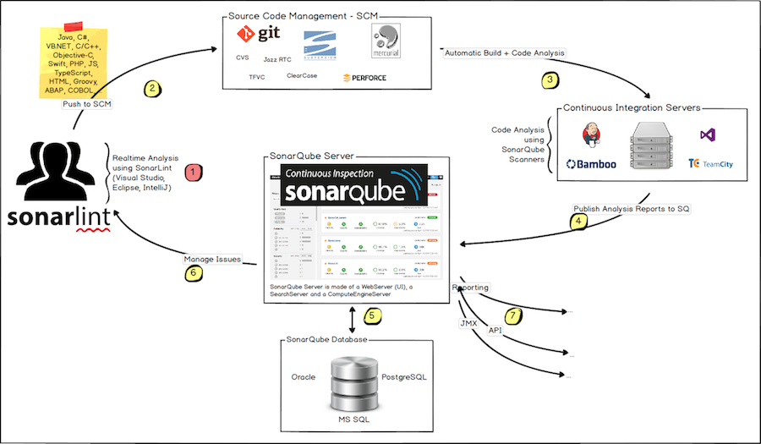

Slide 15
Simplified Process
Coding in IDE
SCM
CI or scripts
SonarQube
Build code
Run tests & gather metrics
Send results to SonarQube
Collects & stores results
Analyzes based on rules
Alerts/notifications
Using linter in IDE for local analysis
Run SonarScanner tool
After code review etc everything’s merged
Pushed to SCM
Send thru CI or run scripts

Slide 16
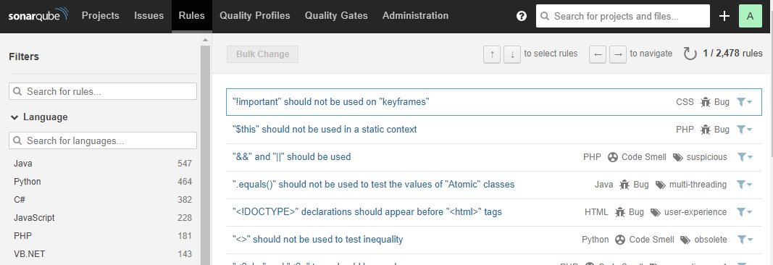

Slide 17
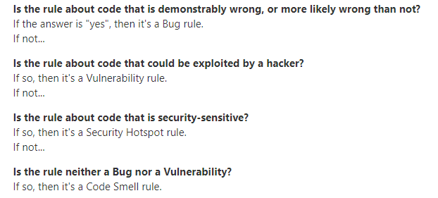
https://docs.sonarqube.org/latest/user-guide/rules/

Slide 18
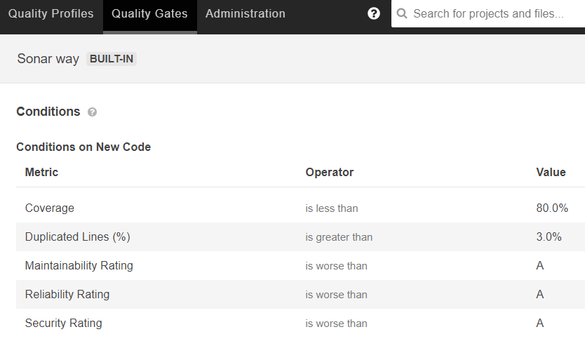
Enforcing the Rules
Quality Gates

Slide 19
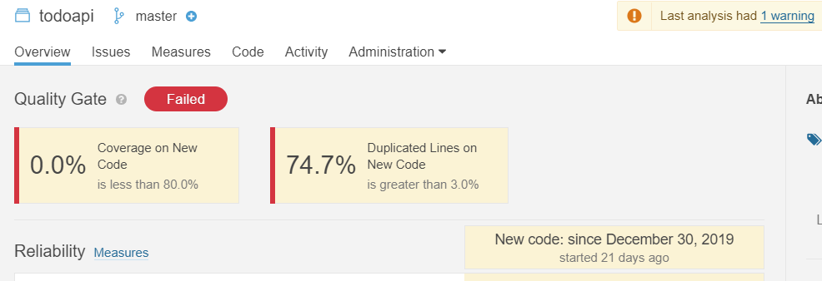

Slide 20
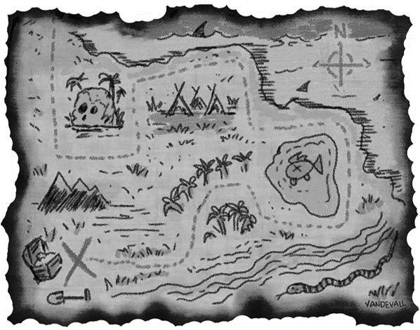

Bugs

Slide 21
Bugs
A coding error that will break your code and needs to be fixed immediately.
https://docs.sonarqube.org/latest/user-guide/issues/

Slide 22
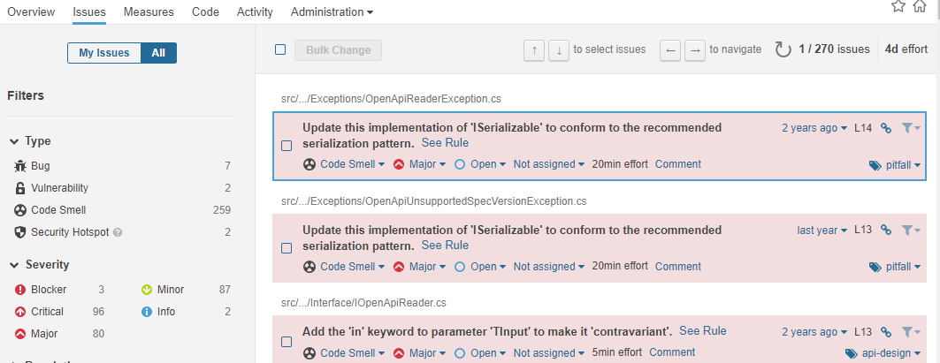

Slide 23
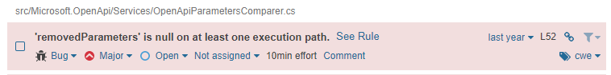

Slide 24
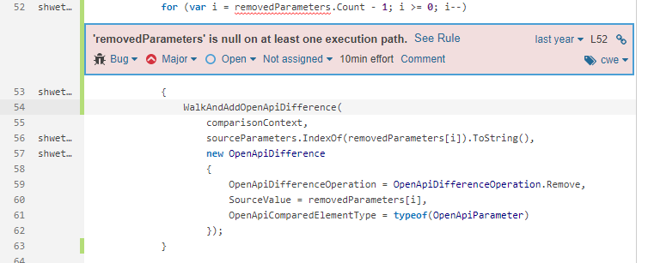

Slide 25
Bugs – What’s The Risk?
Broken code
Downtime
Lost reputation
Lost money

Slide 26
Bugs – Mitigate The Risk!
Fix identified bugs
Get them prioritized
Get them fixed
Learn from what needed fixing (add tests!)
Keep an eye on the bug list!

Slide 27

Security

Slide 28
Vulnerabilities
A point in your code that’s open to attack
https://docs.sonarqube.org/latest/user-guide/issues/
Security Hotspots aren't necessarily issues that are open to attack. Instead, Security Hotspots highlight security-sensitive pieces of code that need to be manually reviewed.
https://docs.sonarqube.org/latest/user-guide/security-hotspots/

Slide 29
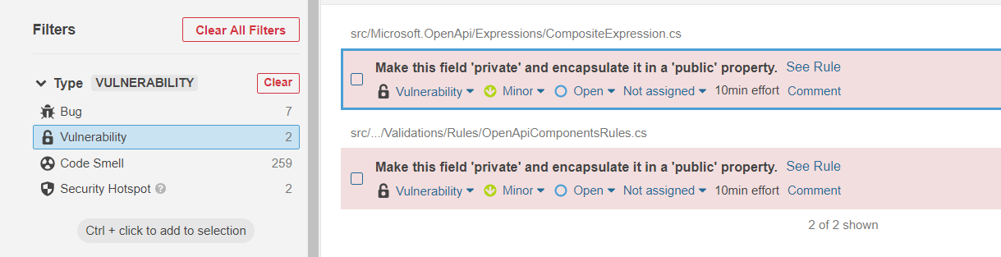

Slide 30
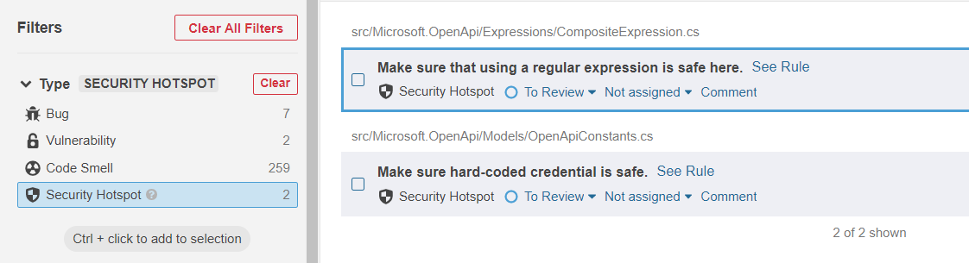

Slide 31
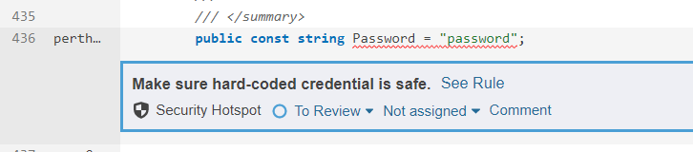

Slide 32
Vulnerabilities – What’s The Risk?
Increase hackability
Exposing users to security risks
Liability

Slide 33
Vulnerabilities – Mitigate The Risk!
Fix identified vulnerabilities
Assign folks to review Security Hotspots
Further security scans should be done!

Slide 34


Code Smells

Slide 35
Code Smells
A maintainability issue that makes your code confusing and difficult to maintain.
https://docs.sonarqube.org/latest/user-guide/issues/

Slide 36
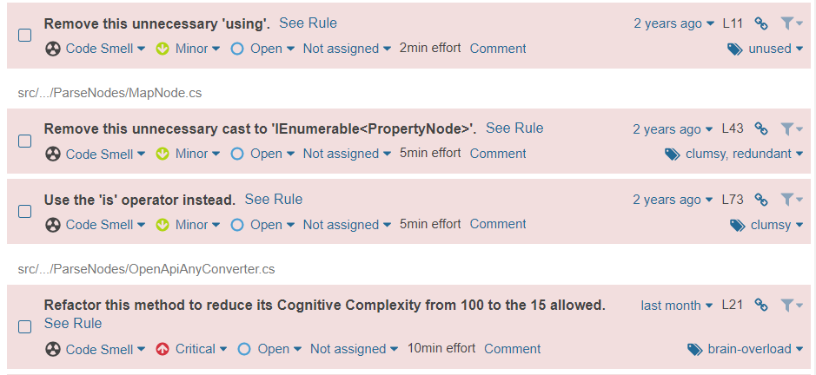

Slide 37
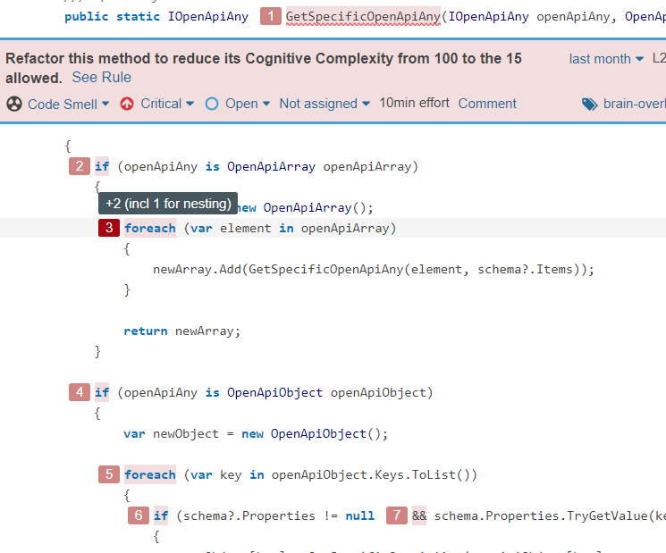

Slide 38
Code Smells – What’s The Risk?
Maintenance headaches
Longer to find/update what needs to be changed
Bugs can be introduced more easily

Slide 39
Code Smells – Mitigate The Risk!
Fix identified issues
Tech debt usually comes last in priority – change that!
Learn from what needed fixing

Slide 40
Duplications

Slide 41
Duplications
Identical lines of code (with a formula to determine duplicated blocks)
https://docs.sonarqube.org/latest/user-guide/metric-definitions/

Slide 42
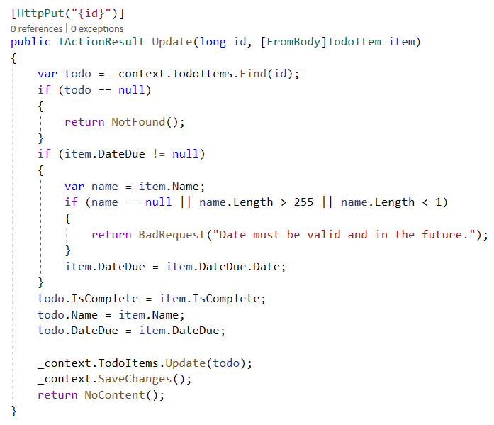
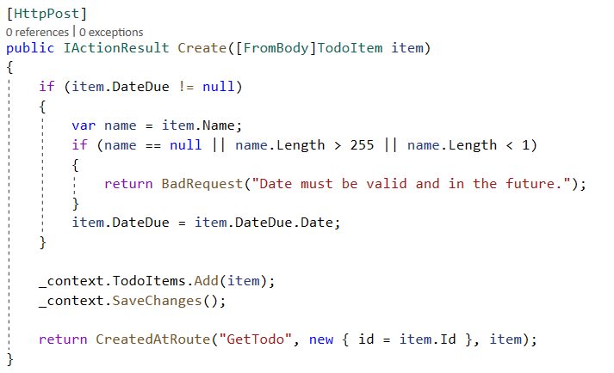
What Does it Mean?

Slide 43
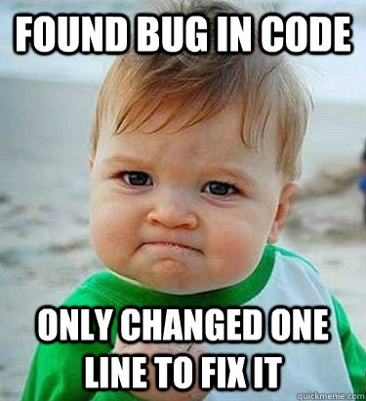

Slide 44
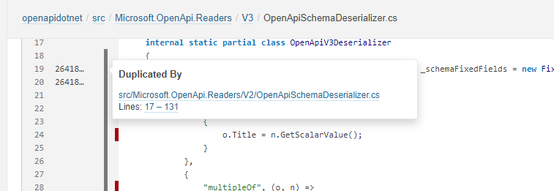

Slide 45
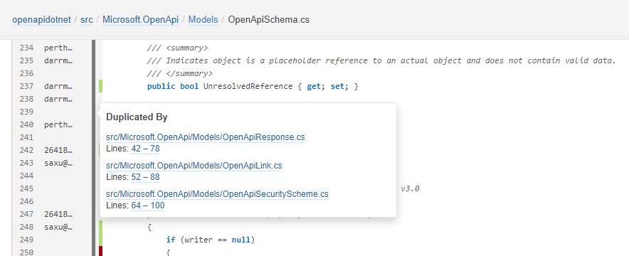

Slide 46
Duplications – What’s The Risk?
Maintenance nightmare
Easy to introduce bugs
Miss updating one of the duplicates
Copy/paste without looking at context

Slide 47
Duplications – Mitigate The Risk!
Abstract out rather than copy and paste
Utilize exclusions where appropriate

Slide 48

Code Coverage

Slide 49
Coverage
On a given line of code, Line coverage simply answers the following question: Has this line of code been executed during the execution of the unit tests?
https://docs.sonarqube.org/latest/user-guide/metric-definitions/

Slide 50
Code Coverage
Measure of how much of the code is executed when unit tests are run
Or
How much of the code is NOT unit tested
Not
How high quality the code is

Slide 51
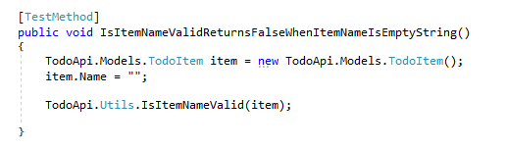
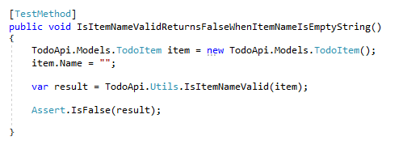
5.05%
Coverage
5.05%
Coverage

Slide 52
5.05%
Coverage
¯\_(ツ)_/¯
Quality

Slide 53
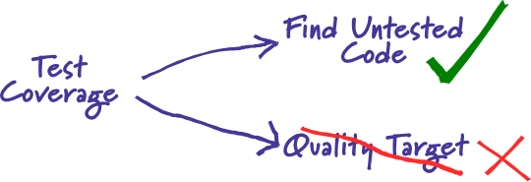
“Test coverage is a useful tool for finding untested parts of a codebase.
Test coverage is of little use as a numeric statement of how good your tests are.”
https://martinfowler.com/bliki/TestCoverage.html

Slide 54
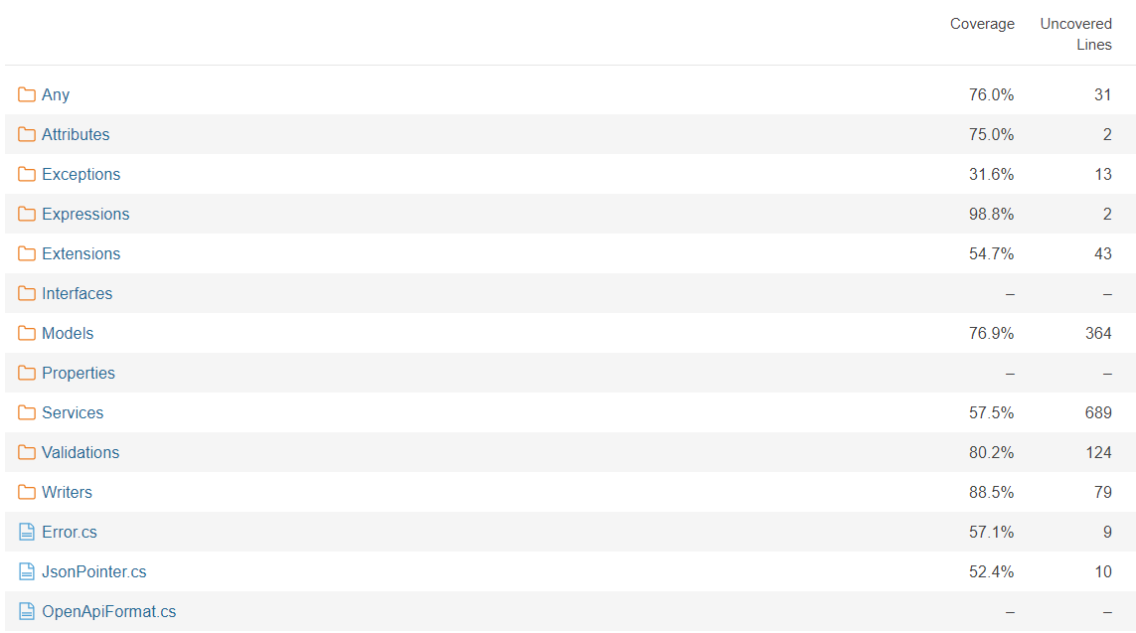

Slide 55
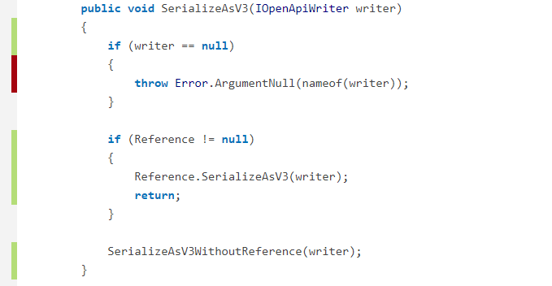

Slide 57
Coverage – What’s The Risk?
100% coverage means we’re PERFECT QUALITY!
Metrics => Manipulation
Are things really being tested at a base level?

Slide 58
Coverage – Mitigate The Risk!
Review unit tests
Are they testing the right thing?
Are they testing *anything*?
Understand how coverage is calculated
Mocks increase coverage!
ExcludeFromCodeCoverage
Get untested areas some tests

Slide 59
Use Your Treasure Maps!

Slide 60
Hidden Treasure of Static Analysis
Treasure trove of information
Absolutely not just for managers – it’s for everyone!
Show the map to your team

Slide 61
Resources
https://www.sonarqube.org/
https://en.wikipedia.org/wiki/List_of_tools_for_static_code_analysis

